Slide 1

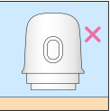
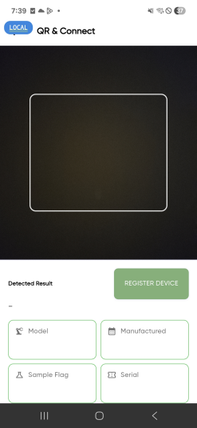
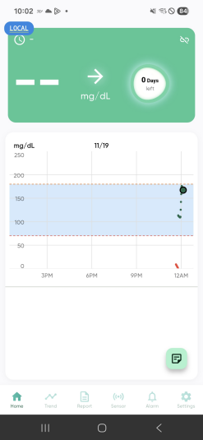
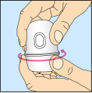
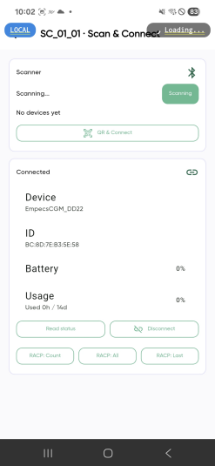
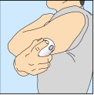
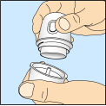
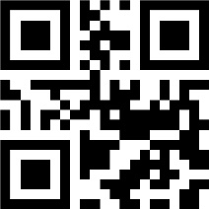
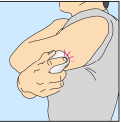
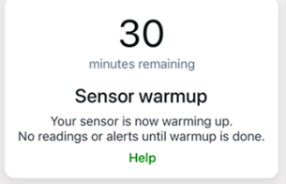
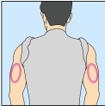
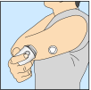
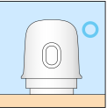
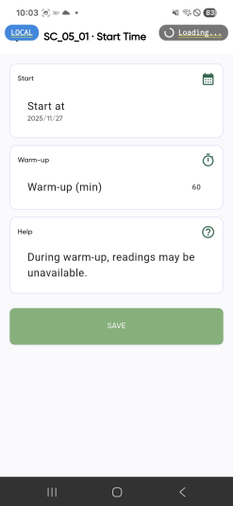
▣ App 화면 구성 요청
QR Scan → Warm-Up Screen
Sensor Connect
Display attachment guide instructions upon touching “QR Scan.“
After scrolling through the guide, touch the [Sensor Connect] button.
Subsequently, the camera screen is displayed, the sensor connects, and a countdown pop-up appears
The countdown runs from 30 minutes down to 0 minutes; once 0 minutes is reached, the pop-up disappears, and the first measurement value is displayed
EMPECS Medical Device Co., Ltd. All Rights reserved.

Slide 2
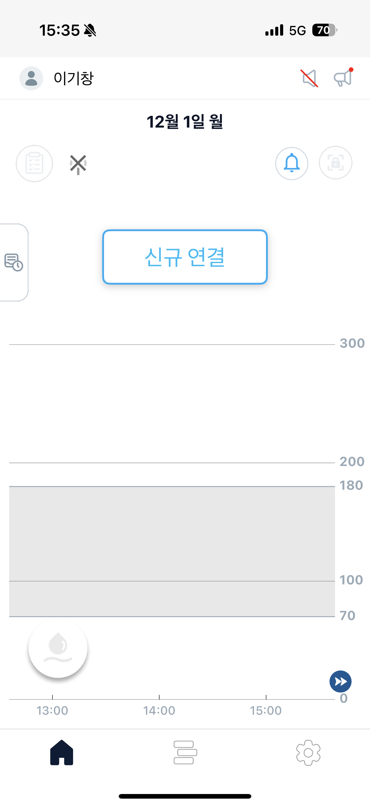
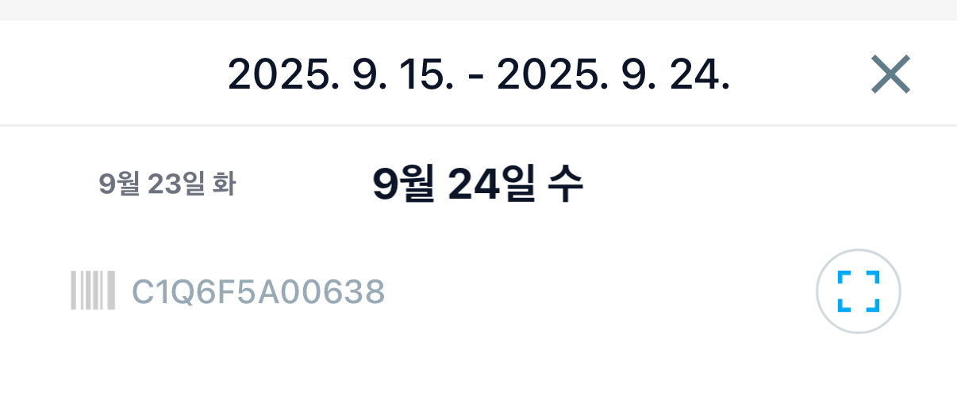
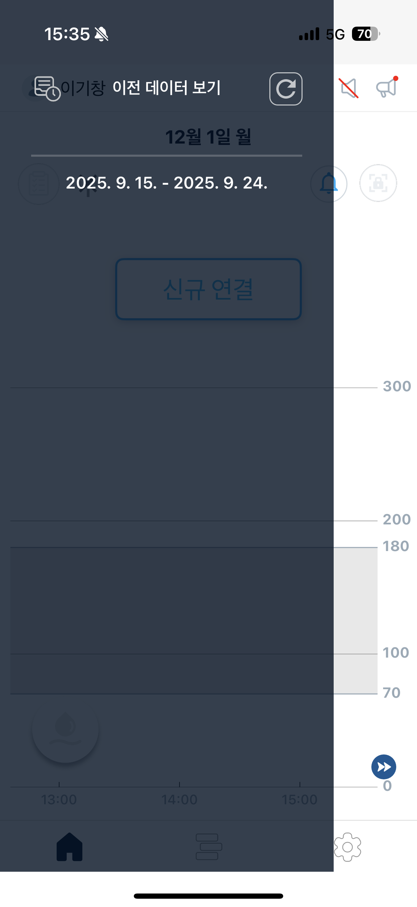
▣ App 화면 구성 요청
Touching the button at the bottom right of the main screen adds a pop-up for the "View Previous Data" function
Touch the bottom right button
Display the "View Previous Data" pop-up
Refresh upon touching the button from step 1.
Download previous records stored on the server
The downloaded information is saved on the device and can be viewed even without an internet connection.
Selecting the button from step 2 loads the graph information recorded during the corresponding period
The period corresponding to step 2 is data per sensor
2025.09.25~2025.10.08→ Data for C21ZS00102 (Sensor2)
2025.09.15~2025.09.24 → Data for C21ZS00101 (Sensor1)
The data is ordered with the most recent sensor stacked at the top
The graph shows the continuous data from the start date to the end date
Touching the [X] button returns to the previous main screen $\rightarrow → navigates to the current sensor's measurement screen
Previous data view screen
Return to the main screen upon touching the previous screen.
Touch the icon
Measurement period
Previous screen
1
sensor serial number
2
2025. 10. 9 - 2025. 10. 23
Upon touching the period
2025. 9. 25 - 2025. 10. 8
View Previous Data button → Select Period → View Previous Records → Touch [X] button → Return to Main Screen
●
●
●
EMPECS Medical Device Co., Ltd. All Rights reserved.

Slide 3
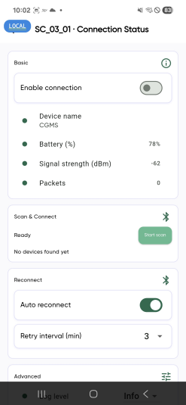
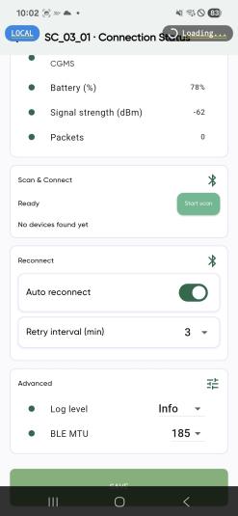
▣ App 화면 구성 요청
Sensor Screen – SC_03_01 Connection Status
Before change
After change
Connecting / No sensor connected
Display only the sensor connection status information
Connecting/Disconnected
EMPECS Medical Device Co., Ltd. All Rights reserved.

Slide 4
▣ App 화면 구성 요청
Sensor Screen – SC_05_01 Start Time
Before change
After change
Start Time automatically updates to match the start date and time.
Delete Warm-Up Time section
Check only the sensor start date and time
Change the screen layout to match the configuration shown after the right-side modification
OK
EMPECS Medical Device Co., Ltd. All Rights reserved.

Slide 5
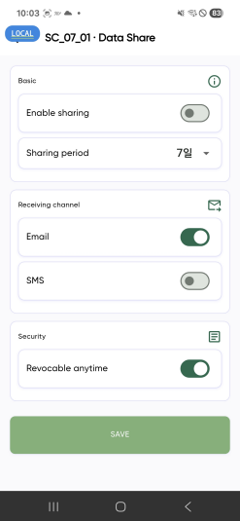
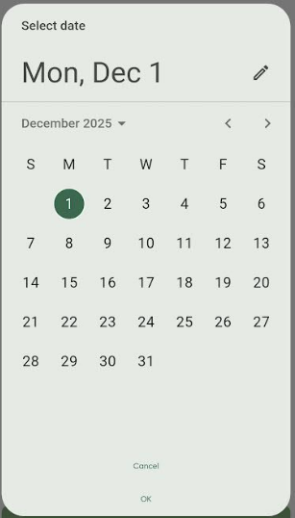
▣ App 화면 구성 요청
Sensor Screen – SC_07_01 Data Share
Modification request
Select the date you want to share
Select a custom date instead of the 1, 7, or 30-day options.
Ex) If only 1 day is selected, one day's worth of information is shared. If 1 to 6 days are selected, the information for the specified days is shared.
Select item in sharing range
Glucose data: Summary, Range Distribution, and Glucose Graph in the Report.
User Profile
Select sharing method
Share via methods such as Email and SMS (.CSV, PDF)
Revocable anytime Delete
This section reconfirms consent for information sharing, similar to a pop-up notification before sharing
Sharing settings
Glucose data
User Profile
EMPECS Medical Device Co., Ltd. All Rights reserved.

Slide 6
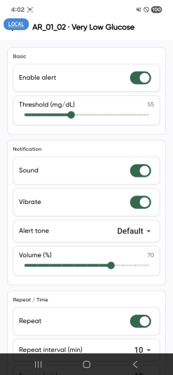
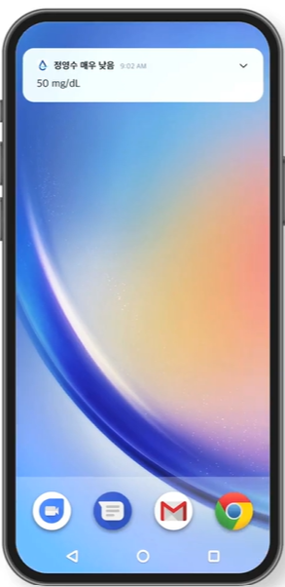
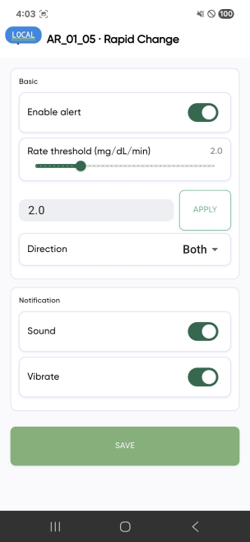
▣ App 화면 구성 요청
Alarm Screen – AR_01_02 Very Low Glucose
Before change
After change
Alarm On/Off
Select very low glucose range.
Select Sound/Vibration Mode.
Sound only if 'Sound Only' is selected
Vibration only if 'Vibration Only' is selected.
Sound + Vibration if both are selected.
Select notification sound
Display banner upon notification
Override Do Not Disturb Mode feature On/Off
On: Alarm/Alert even when the phone is in Do Not Disturb Mode.
Off: Alarm/Alert Off when in Do Not Disturb Mode.
→ This section only applies the very low glucose alert.
Display banner upon alarm
Very Low glucose alert
방해 금지모드 무시
EMPECS Medical Device Co., Ltd. All Rights reserved.

Slide 7
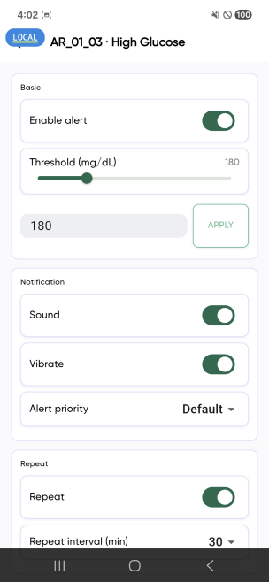
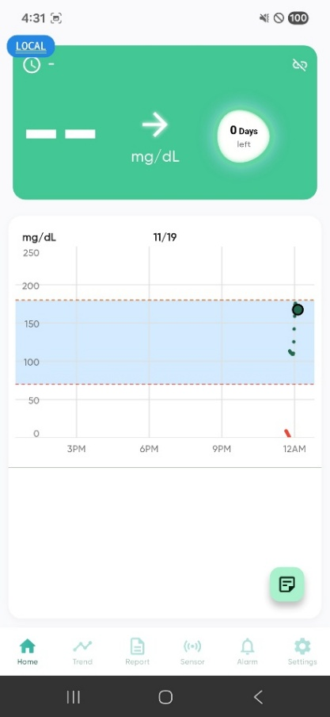
▣ App 화면 구성 요청
Alarm Screen – AR_01_03 High Glucose
After change
Display banner upon alarm
0
High glucose alert
Alarm On/Off
Select high glucose range
Graph line changes according to the set value
Select Sound/Vibration Mode.
Sound only if 'Sound Only' is selected
Vibration only if 'Vibration Only' is selected.
Sound + Vibration if both are selected.
Select notification sound
Display banner upon alarm
EMPECS Medical Device Co., Ltd. All Rights reserved.

Slide 8
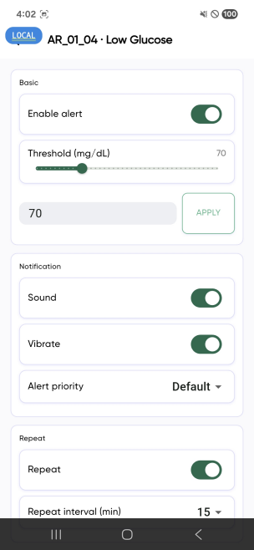
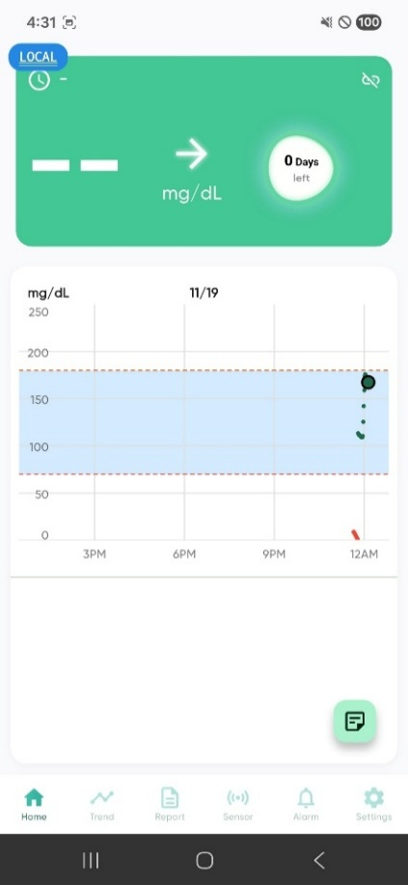
▣ App 화면 구성 요청
Alarm Screen – AR_01_04 Low Glucose
After change
Display banner upon alarm
0
Low glucose alert
Alarm On/Off
Select Low glucose range
Graph line changes according to the set value
Select Sound/Vibration Mode.
Sound only if 'Sound Only' is selected
Vibration only if 'Vibration Only' is selected.
Sound + Vibration if both are selected.
Select notification sound
Display banner upon alarm
EMPECS Medical Device Co., Ltd. All Rights reserved.

Slide 9
▣ App 화면 구성 요청
Alarm Screen – AR_01_05 Rapid Change
Display banner upon alarm
0
Rapid Change Alarm
[Rapid Change Range]
Alarm On/Off
Select Rapid Change range
Select Sound/Vibration Mode.
Sound only if 'Sound Only' is selected
Vibration only if 'Vibration Only' is selected.
Sound + Vibration if both are selected.
Select notification sound
Display banner upon alarm
EMPECS Medical Device Co., Ltd. All Rights reserved.

Slide 10
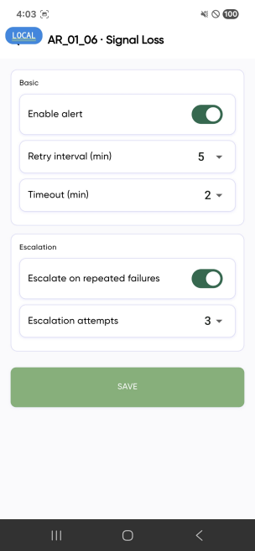
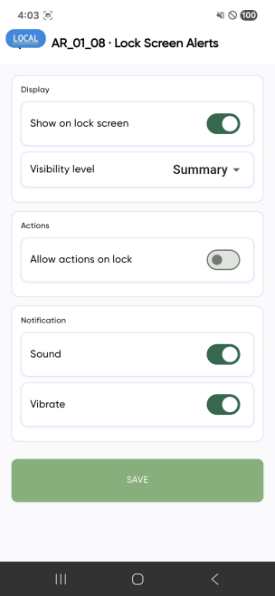
▣ App 화면 구성 요청
Alarm Screen – AR_01_06 Signal Loss
Before change
After change
Since this section is not for user configuration, revise it to match the post-modification version.
Delete the item(s) in the displayed section
Items in the alarm method can be selected.
Sound + Vibration if both are selected.
EMPECS Medical Device Co., Ltd. All Rights reserved.

Slide 11
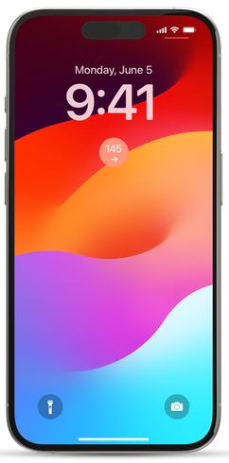
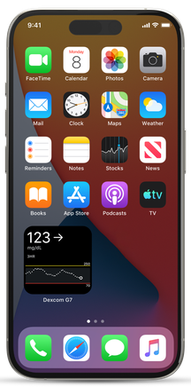
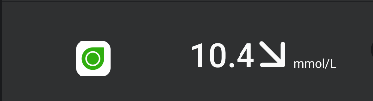

▣ App 화면 구성 요청
Alarm Screen AR_01_08 Lock Screen Alerts
Lock Screen (Example 1)
Main Screen (Example 2)
Display Activate item
Banner notification on the Lock Screen.
Always display banner on the Lock Screen
Display the latest glucose value and trend arrow.
Adding a widget to the Main Screen also adds an item to the Main Screen.
Add widget to the Main Screen.
Display graph, latest glucose value, and trend arrow.
These parts update with regular refreshes
EMPECS Medical Device Co., Ltd. All Rights reserved.

Slide 12
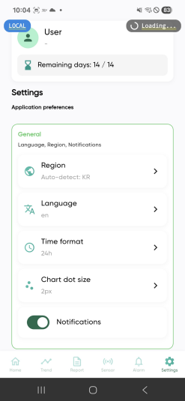
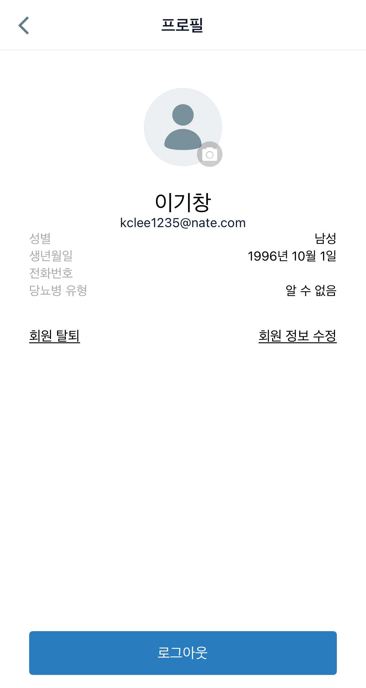
▣ App 화면 구성 요청
Setting Screen – ST_01_01 User Screen
Touch
Feature to modify personal information upon selecting the User section.
Name and email address cannot be changed, as they are displayed as login information
Gender, date of birth, phone number, and type of diabetes can be modified when editing member information
Automatically select Region.
Automatically select by recognizing the country of login.
Automatic language matching based on the country selected in Region.
Language matching based on the selected country → if no match is found, the default language is English.
Apply the time display change feature upon selecting Time Format.
24h: 24-hour format.
12h: 12-hour format (AM/PM distinction for morning/afternoon)
name
E-mail
EMPECS Medical Device Co., Ltd. All Rights reserved.

Slide 13
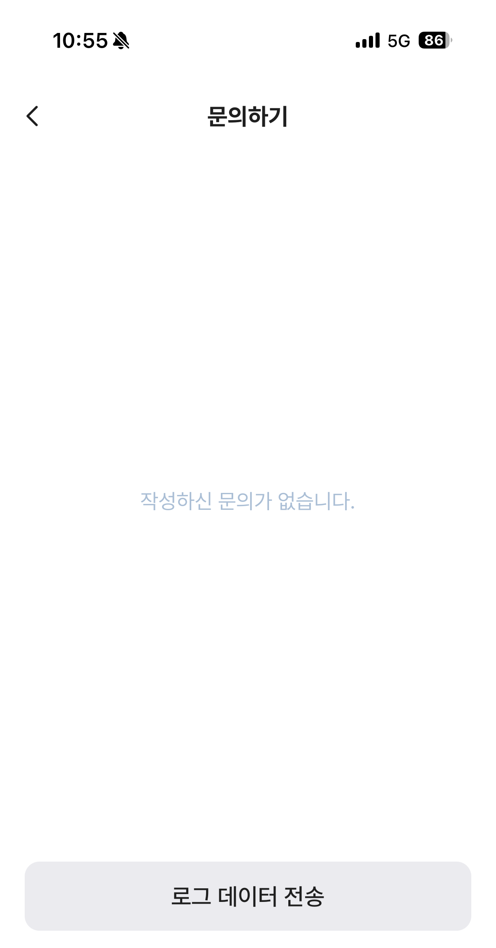
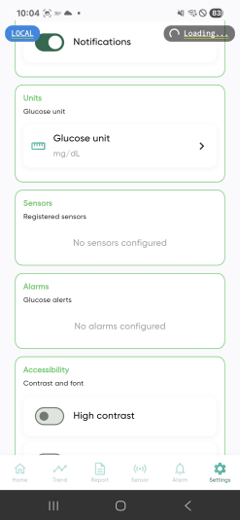
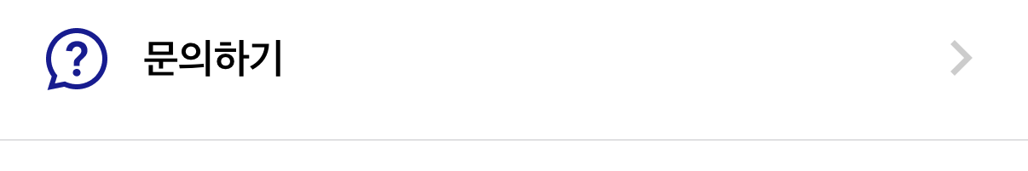
▣ App 화면 구성 요청
Setting Screen – ST_01_01 User Screen
2025.12.01
Transmission Completed.
Upon tapping Log Data Transmission, display the transmission date and Transmission Completed.
Addition of the Inquiry section
Function of log data transmission
If the user encounters an issue that they suspect is caused by a sensor defect during use
Select the [Log Data Transmission] section.
Information being transmitted: Data for troubleshooting, such as communication history between the sensor and the device
Ex) Log transmission of information necessary to check/resolve issues such as sensor/device disconnection, sudden connection loss, or premature battery drain due to a sensor anomaly.
Feature for transmitting log data from the sensor to our company.
EMPECS Medical Device Co., Ltd. All Rights reserved.

Slide 14
Thank You
EMPECS Medical Device Co., Ltd. All Rights reserved.

